Slide 1
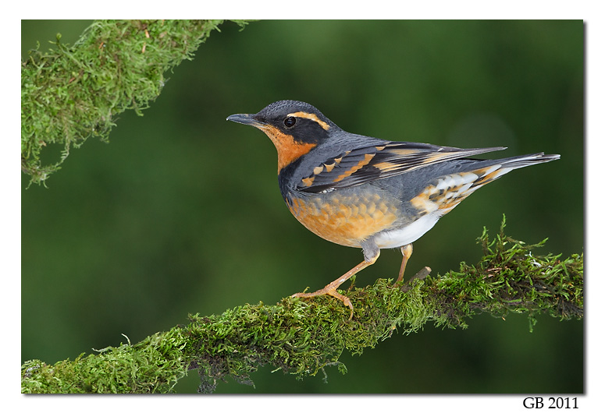
Breeding Bird Response to
Riparian Buffer Width
10 years post-harvest
Scott Pearson
Washington Department of Fish & Wildlife
Jack Giovanini, Jay Jones, &
A.J. Kroll
Weyerhaeuser NR

Slide 2
Drivers?
Intense societal interest in PNW riparian systems
  Variation in buffer prescriptions on private, state, and Federal lands
Poorly defined outcomes for terrestrial elements
Lack of long-term studies
  Marczak et al. 2010. Ecological Applications 20: 126-134.

Slide 3
Process
Original study design and report - University of (TFW-LWAG1-00-001)
Bird portion of the study published in peer review literature
Re-sampling 10 years post-harvest - V. Hawkes LGL
10 year post-harvest bird data – WDFW/Weyerhaeuser
Report reviewed by LWAG and then revised
ISPR review (SRC 13-14-01) - Dr. John Richardson synthesized the reviews
  “There are exceedingly few studies that revisit such experiments…”
  “report provides new insights into the use of riparian area buffers by birds as adjacent forests regrow.”
  “the reviewers are very positive…., but also have some suggestions for how it can be improved.”
Comment and response matrix – response and revisions
The revised final report was approved by CMER
Next step = manuscript submission to Ecological Applications

Slide 4
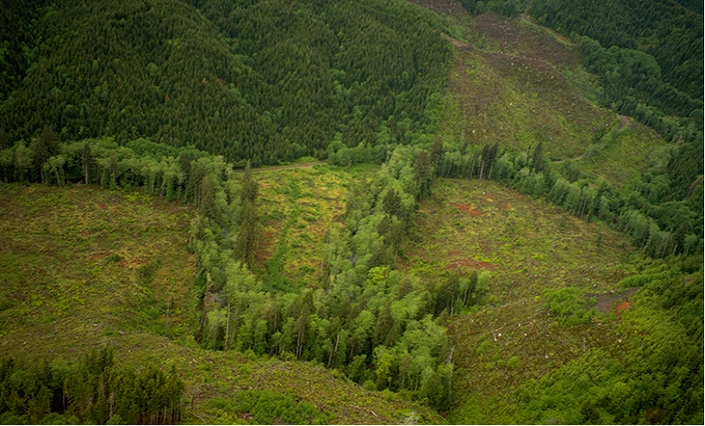
Washington Forest Practice Rules - Riparian Buffer
What roles do RMZs, UMAs, and other forest patches play in maintaining species and providing structural and vegetative characteristics thought to be important to wildlife?
Notes:
Contract:
Westside: Steve West and Dave Manuwal
Eastside: Peggy O’Connell and Jim Hallett

Slide 5
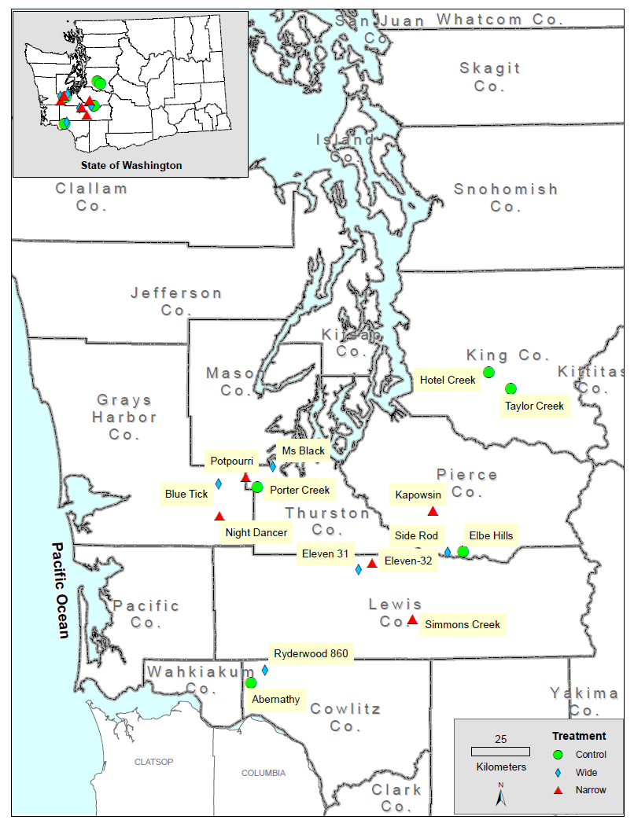
PRESCRIPTIONS
Random selection and prescription application
CONTROL: No harvest
NARROW: 13 m (SD=9.1)
WIDE: 30 m (SD=15.5)

Slide 6
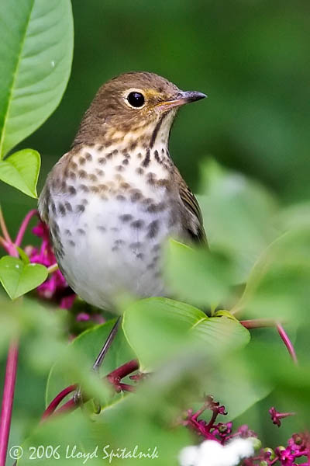
BACKGROUND
1993 -> sampling
1994 -> harvesting
1995-1996 -> sampling
  Pearson and Manuwal 2001
2003-2004 -> sampling
  Pearson, Giovanini, Jones, and Kroll
Notes:
2003-2004 sampling: Virgil Hawkes, LGL Limited environmental research associates

Slide 7
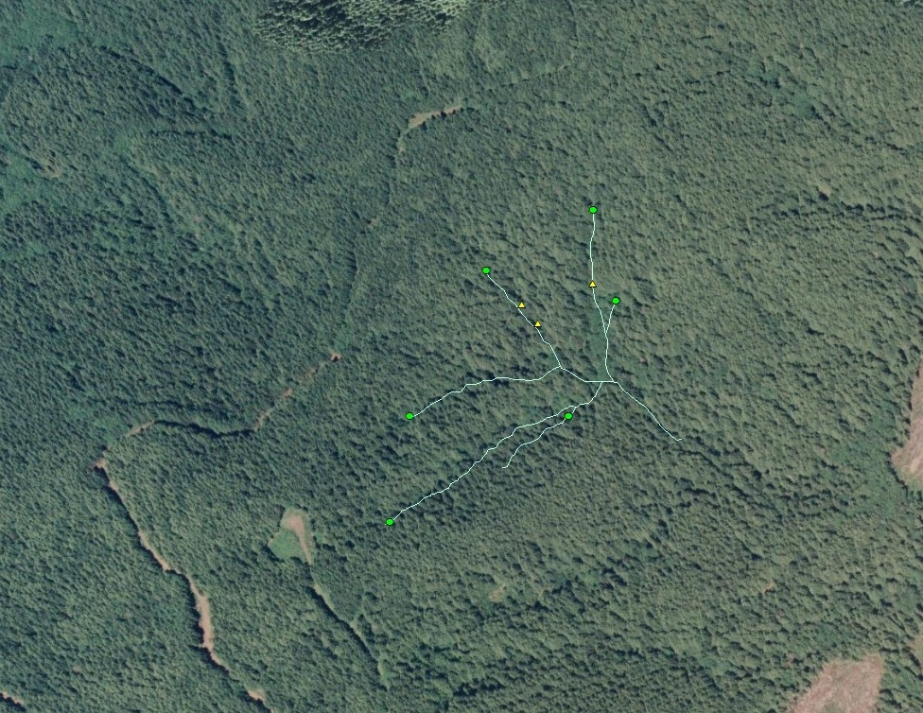
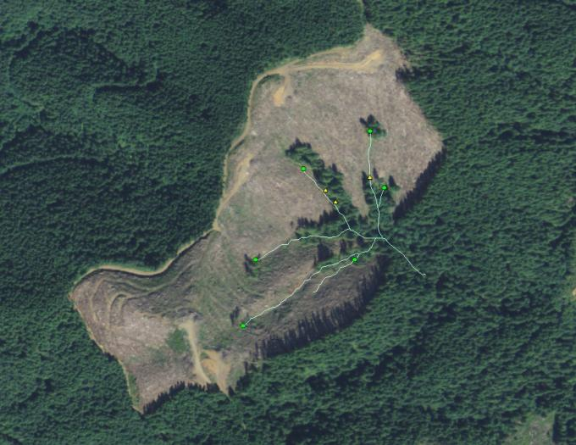
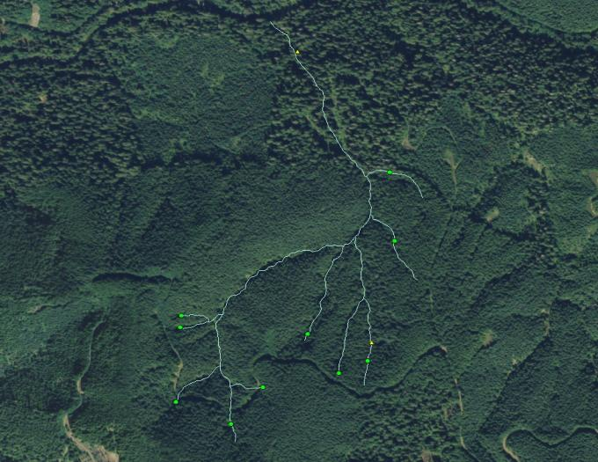
EXAMPLES
Narrow
Buffer
100%
Buffer
Narrow
prescription
Control

Slide 8
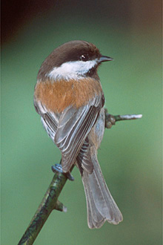
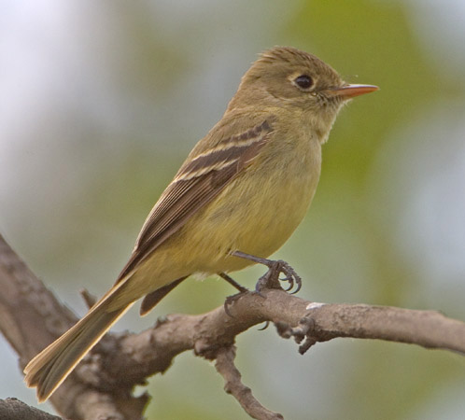
DATA
15 harvest units (through 2003-2004)
  18 harvest units (1993-1996)
Point count sampling
  10 sub-samples per stand (15 m radius)
  6 visits per season
  Samples pooled within each harvest unit for analysis
~30 species of breeding birds
  ≥ 10 detections

Slide 9
Narrow
Wide
Control

Slide 10
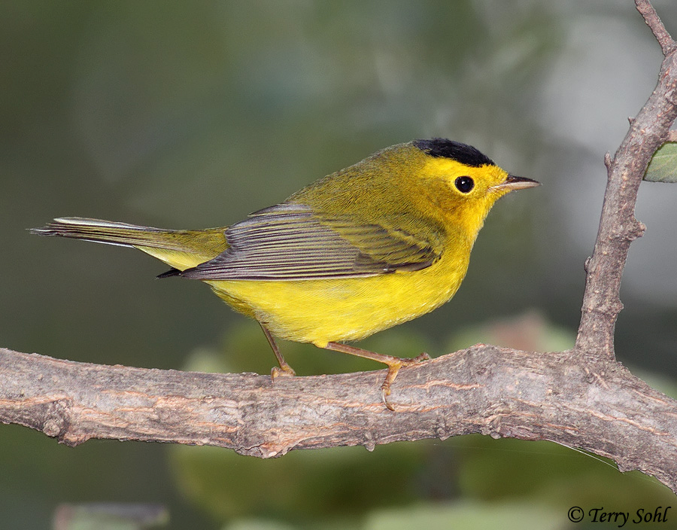
Pearson and Manuwal (2001)
Species richness and turnover increased on narrow buffer treatments relative to controls
Total bird abundance did not differ between treatments and controls
Some evidence that species associated with riparian habitats declined on treatments

Slide 11
New Study
Revisited our study sites ( ̴ 10 years post-harvest)
Used the same Before-After-Control-Impact (BACI) experimental approach
  buffer treatment effects on (species and community)
    occupancy, abundance and richness
    local extinction (site-level species loss) and turnover
  relative influence of riparian buffer width on species occupancy and abundance.
We incorporate contemporary statistical methods to account for potential influence of detectability on apparent treatment effects

Slide 12
INFERENCE
Multi-level models for both occupancy and abundance
  Design model (included a quadratic effect of date on detection)
  ‘Random’ effects of species and site
  Fit within a Bayesian framework
Linear contrasts to evaluate treatment × year effects
2nd model with a random effect for harvest unit
  Evaluate buffer width as a continuous covariate
  Responses of ‘riparian species’
  2003-2004 data only

Slide 13
Species Richness
Species richness increased on both treatments

Slide 14
Species extinction and turnover
No strong evidence of local extinction
Species turnover was greater on treatments
  Driven by an increase in species

Slide 15
Total bird abundance
Total bird abundance did not differ between treatments and controls

Slide 16
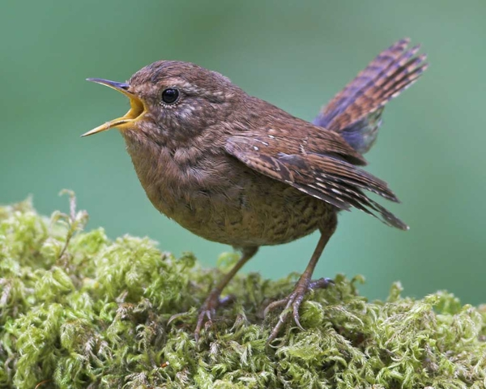
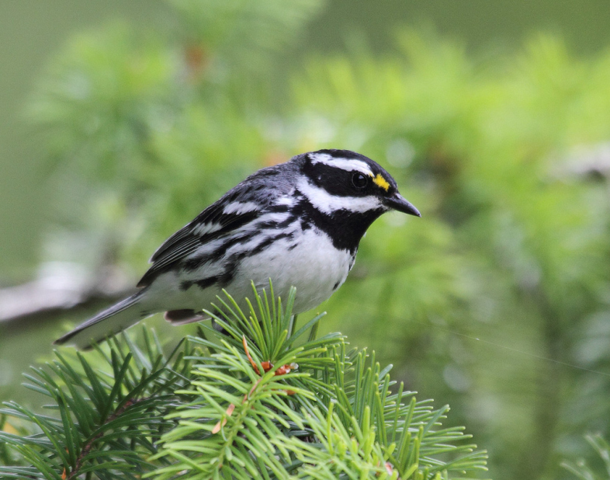
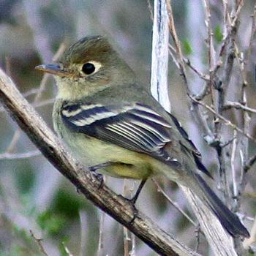
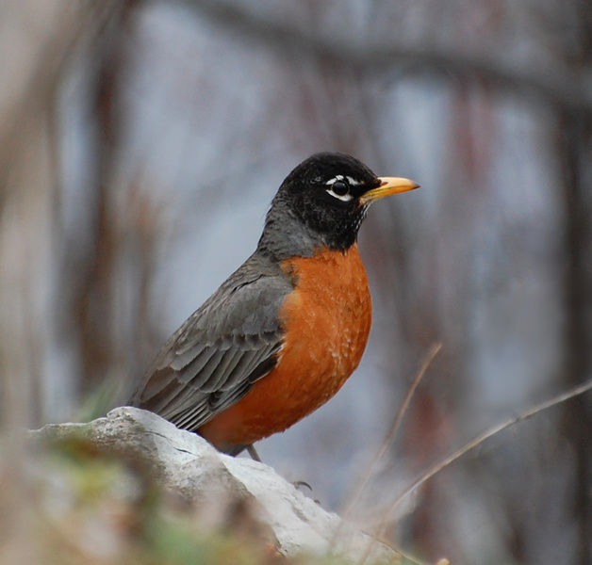
Riparian Associates
Black-throated gray warbler
Pacific wren
Pacific-slope flycatcher
American robin

Slide 17
Abundance of riparian associates
No change in the abundance of riparian associated species on treatments

Slide 18
RESPONSES AS A FUNCTION OF BUFFER WIDTH
Species richness & abundance
Species richness and abundance decreased on some very narrow buffers but not on others

Slide 19
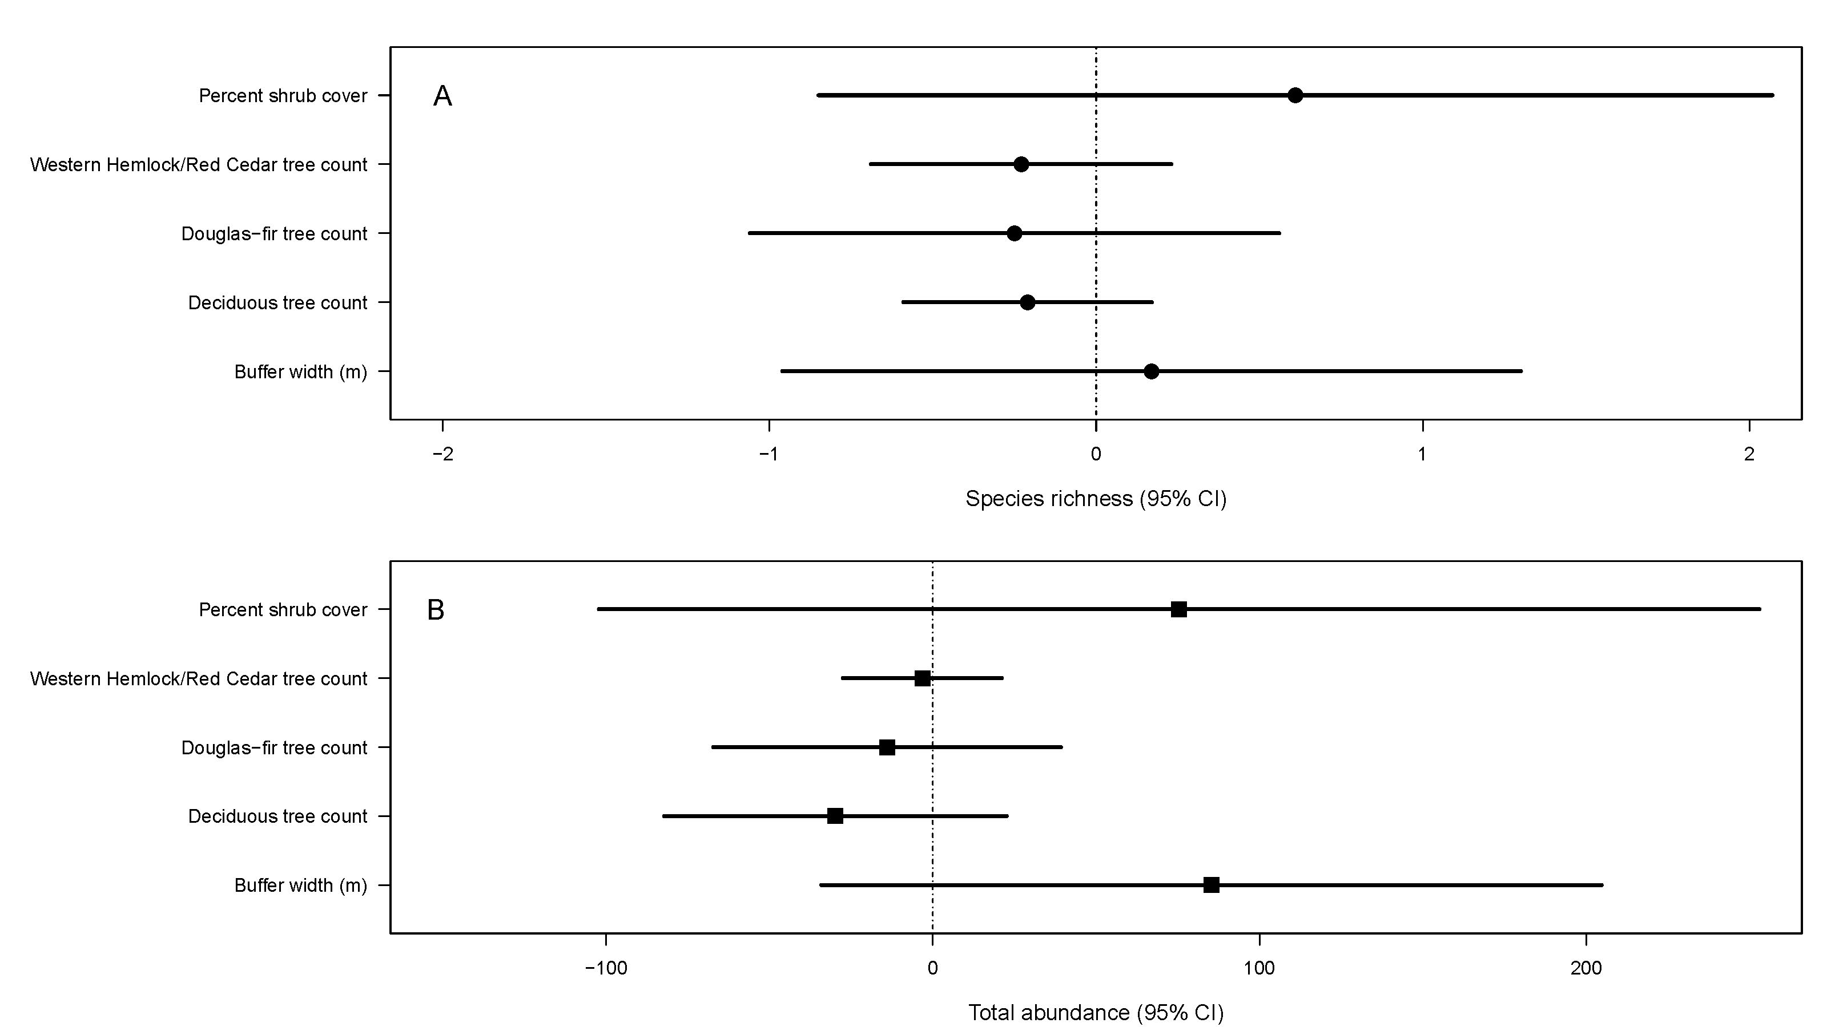
Influence of buffer width and habitat variables on species richness & total abundance
Some evidence for the influence of buffer width on abundance & richness

Slide 20
SPECIES RESPONSES AS A FUNCTION OF BUFFER WIDTH
Abundance or riparian associates
No change in the abundance of riparian assoicated species

Slide 21
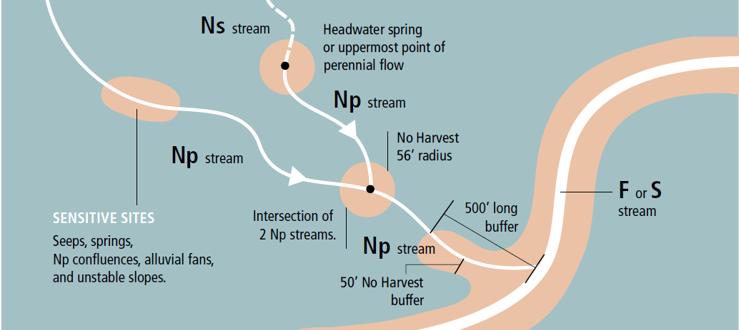
Putting our results in context
NARROW < Current Prescription < WIDE

Slide 22
CONCLUSIONS
Strong evidence for high turnover on the treatments
  The treatments contained more species post-harvest
Weak evidence for species loss and strong evidence for species gain on treatments
Species occupancy increased over time
Little evidence for treatment effects on total abundance
Little evidence for treatment effects on abundance of ‘riparian specialists’
Buffer width (‘Random effects’ model) results:
  Evidence for reduced total abundance and richness on some very narrow buffers but not others
  No reduction in abundance of riparian associates

Slide 23
Cautions
Does not tell us if birds within narrow buffers are successfully reproducing.

Slide 24
Treat buffer as a continuous variable
Some loss of species and some decrease in total bird abundance occurred on two very narrow buffer stands (40’ ≤) but not on others, suggesting that stand-level differences exist in bird response.
No loss of species or decrease in bird abundance occurred on stands with buffers greater than the current 50’ buffer for non-fish bearing streams.

Slide 25
RESPONSES AS A FUNCTION OF BUFFER WIDTH
39
50
69

Slide 26
Acknowledgments
Steve West, Dave Manuwal, Kathryn Kelsey, and Angela Stringer for coordinating the original RMZ study
Virgil C. Hawkes for coordinating the 2003-2004 re-sample
Cooperative Monitoring, Evaluation, and Research (CMER) Committee
Marc Hayes (WDFW)
Champion Pacific Timberlands, City of Seattle, Hampton Tree Farms, Hancock Timber, International Paper, Olympic Resource Management, Plum Creek Timber, The Campbell Group, Washington Department of Natural Resources, and Weyerhaeuser

Slide 27
